Slide 1
Rats & Birds:
Tips and Techniques
for Their Control

Slide 2
Why control them?
They eat and contaminate food
They transmit diseases
Food safety and employee safety concerns
Salmonellosis
Leptospirosis
Histoplasmosis
They damage property
Feces
Gnawing
Burrowing
They harbor parasites

Slide 3
Know Your Foe

Slide 4
Invasive vertebrates
Birds
Feral pigeons
English sparrows
European starlings
Rodents
House mice
Norway rats

Slide 5
Norway rats need water daily
Rats need water on a daily basis
They will live close to a water source

Slide 6
Home range
Will travel between 100 and 450 feet from their burrows

Slide 7
Rats and food sensitivity
Rats cannot vomit
Why is this important?
To rid the body of toxic substances
How do they avoid bad food?
Taste small amounts of food to see if it makes them sick
Food avoidance learning (neophobia)

Slide 8
Neophobia
Neophobia – “fear of new”
Rats may ignore traps, baits, and other devices
If there is plenty of food, why risk trying something new?
Sanitation is key
Removal of food sources
Neophobic rats are forced to investigate new food sources, like baits

Slide 9
Integrated Pest Management

Slide 10
What is integrated pest management?
More than just reliance on pesticides to achieve pest control
Biological control = predators, parasites, pathogens
Physical control = sound, light, heat, cold, humidity
Cultural control = sanitation, altering the environment
Mechanical control = exclusion, spikes, nets, traps
Chemical control = pesticides, least toxic formulations first, moving up in toxicity only when necessary

Slide 11
We don’t have a silver bullet
Pest control isn’t magic
We need your cooperation for a program to succeed
We will educate you on what you can do better
We will use our products according to law and label
We are licensed professionals
We must be:
Biologists
Chemists
Detectives

Slide 12
What Can You Do?

Slide 13
Sanitation
Minimize access to food, water, and shelter for pests
Clean up spills
Keep product off of the floor
Keep product away from the walls (at least 18 inch clearance)
Keep weed growth under control
Weed seed can feed mice
Provide shelter for pests
Increase overall pest pressures on the facility
Consider a gravel border around the facility
Reduce interior and exterior clutter

Slide 14
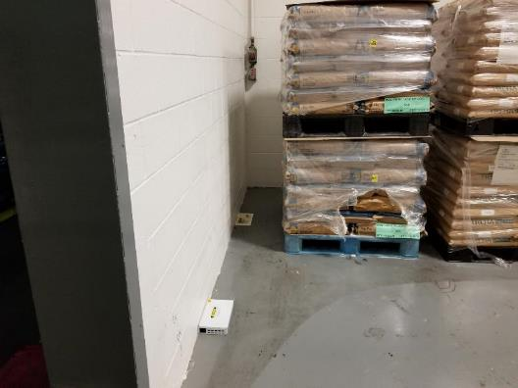
Allow room for inspection

Slide 15
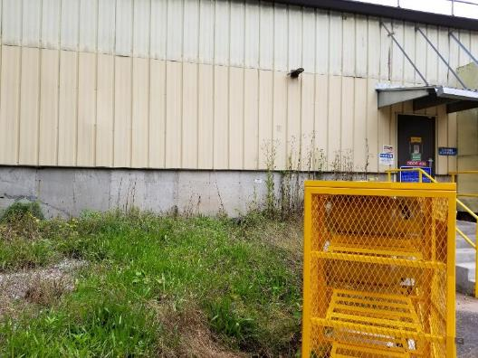
Sanitation concerns

Slide 16
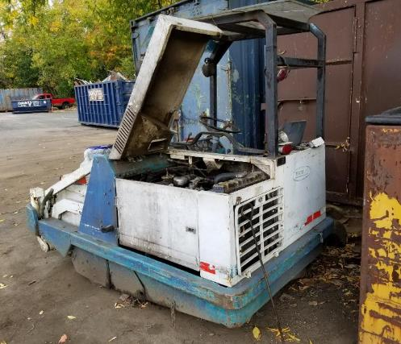
Sanitation concerns

Slide 17
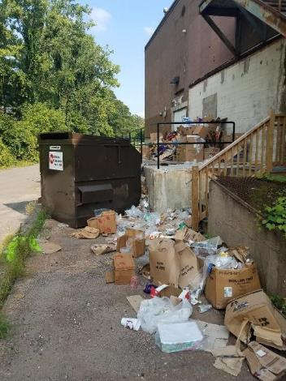
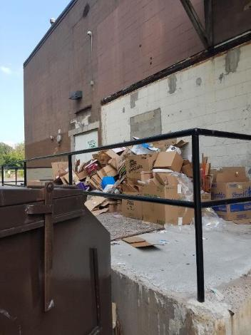
Sanitation concerns

Slide 18
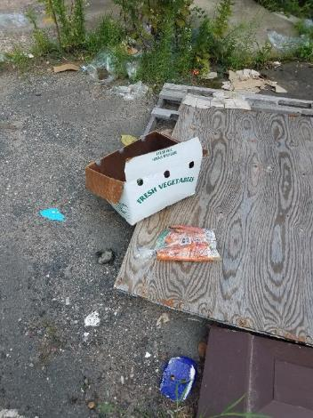
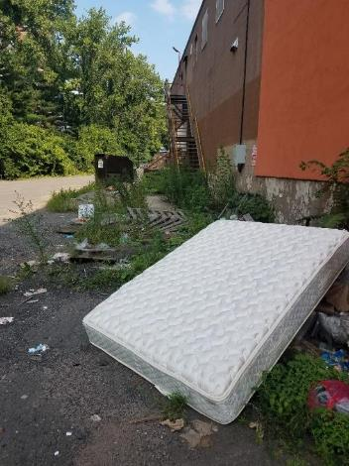
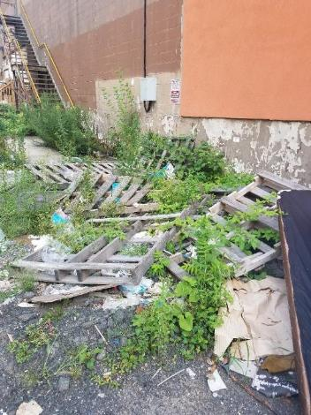
Sanitation concerns

Slide 19
Clutter

Slide 20
Clutter

Slide 21
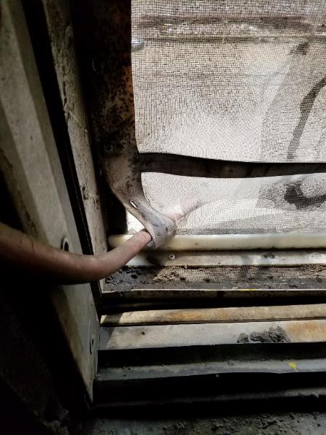
Exclusion
Minimize exclusion issues
Insects—almost any sized hole
Mice—dime-sized
Rat—quarter-sized
Keep all doors closed when not in use
Use screens for dock doors when air flow is needed
Educating staff on the importance of “keeping the doors shut”

Slide 22
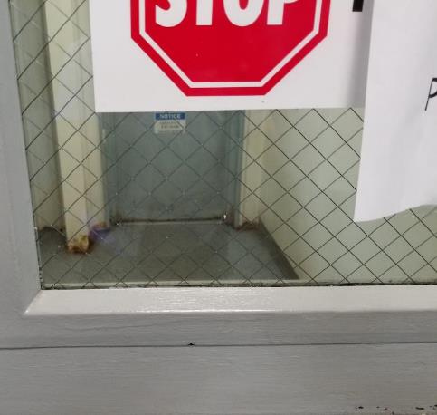
Exclusion

Slide 23
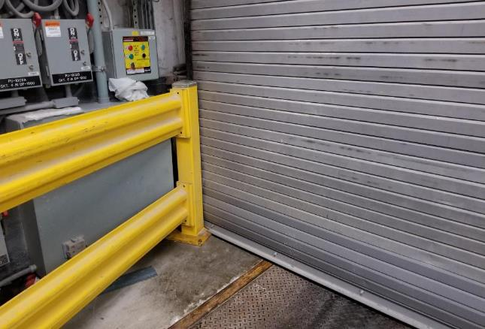
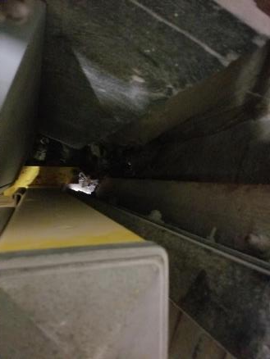
Exclusion
Top down view from yellow rail

Slide 24
Exclusion
Door brush does not touch floor

Slide 25
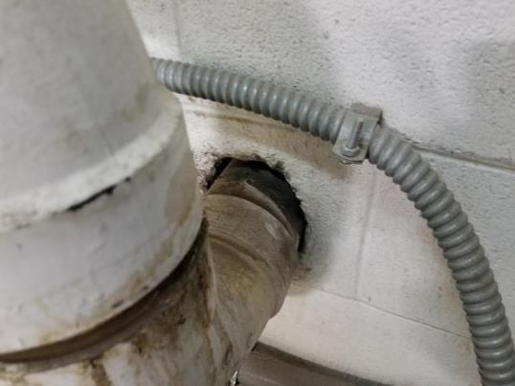
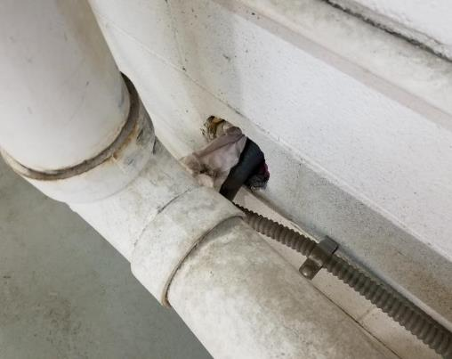
Exclusion
Gaps around pipe penetrations

Slide 26
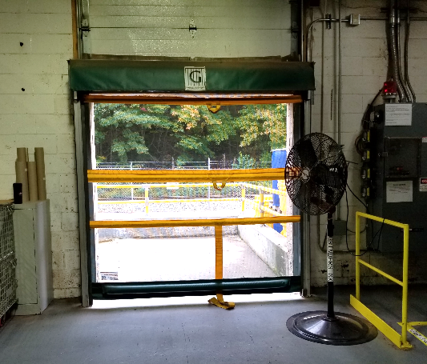
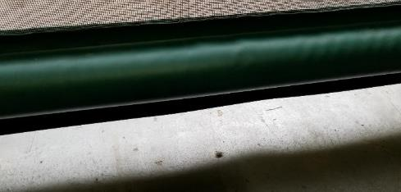
Exclusion
Screen does not touch floor

Slide 27
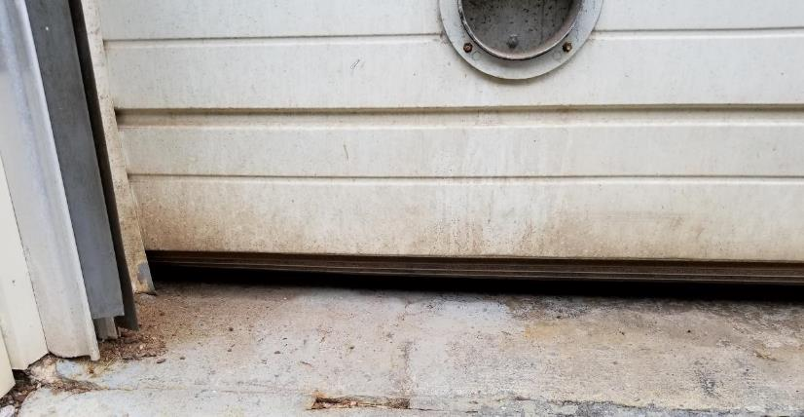
Exclusion
Dock door not closed completely

Slide 28
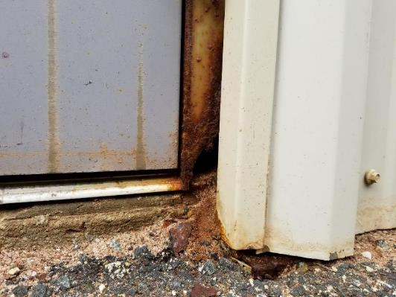
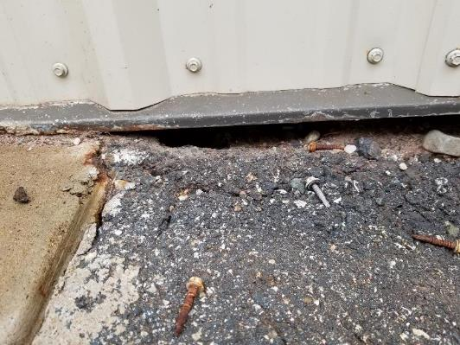
Exclusion

Slide 29
Pest Evidence

Slide 30
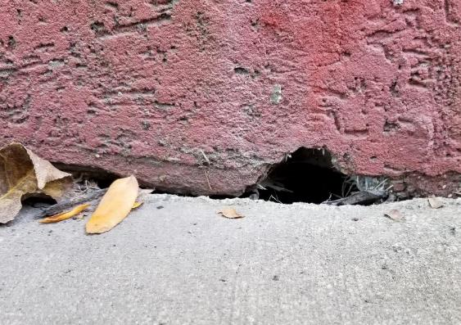
Rat evidence
Rodent sightings
Droppings
Rub marks
Burrows
Tracks

Slide 31
Rodent sightings
Nocturnal, but adaptable
Rodents seen during the day may indicate a large population competing with itself for food resources

Slide 32
Droppings
Most obvious sign of activity
Up to 50 droppings generated per day per rat
Droppings are found in concentrations
Creatures of habit and routine
Indicate high activity areas
Think three-dimensionally
May have fallen from above

Slide 33
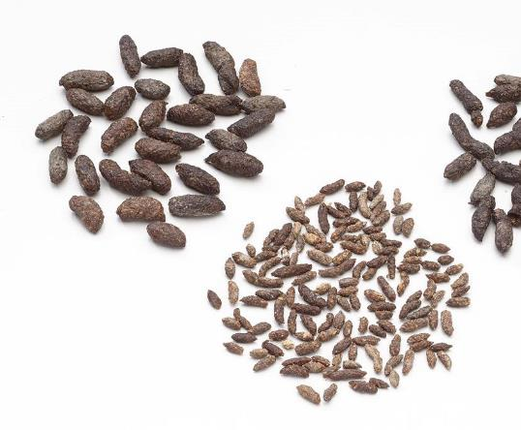
Droppings
Norway rat
Blunt ends, ¾”
House mouse
Pointed ends, ¼”

Slide 34
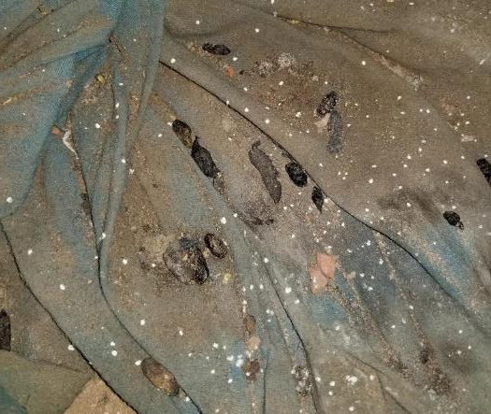
Droppings

Slide 35
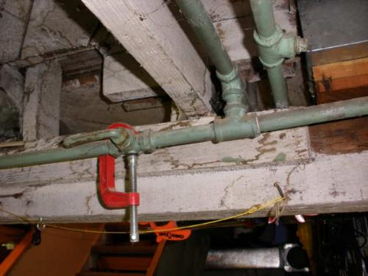
Identify rodent pathways
Rodents usually travel along structural guidelines
Sill ledges
Fence support rails
Foundations
Electrical wires
Pipes
Tree branches
Conduits

Slide 36
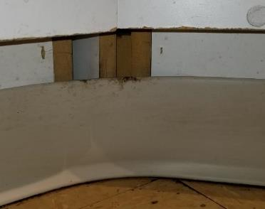
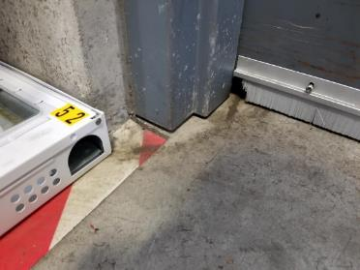
Rub marks
Rodent body oils (called sebum)
Indicate well-used pathways
Fresh rub marks will smear

Slide 37
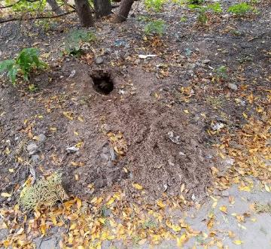
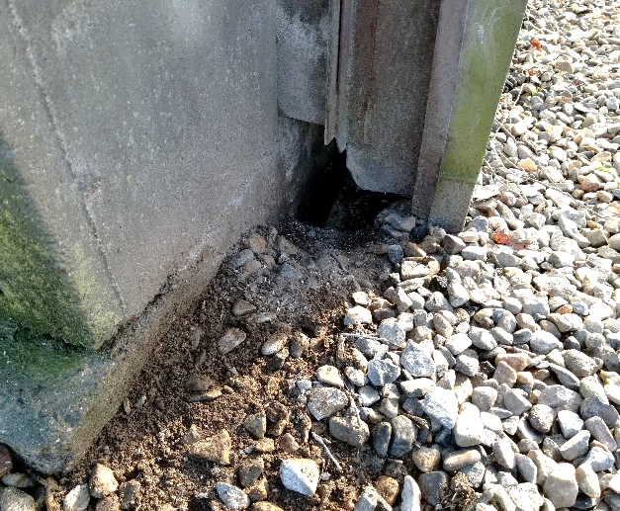
5. Burrows – rats
Norway rats are ground-burrowing animals
Main entrance – about 3 inches in diameter

Slide 38
Burrows under trash bins

Slide 39
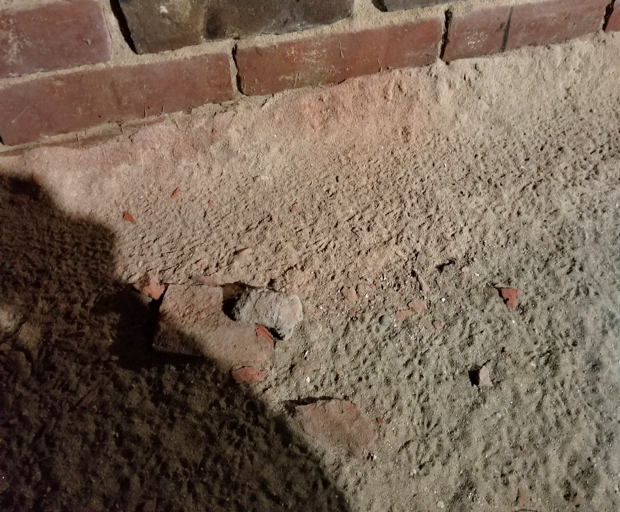
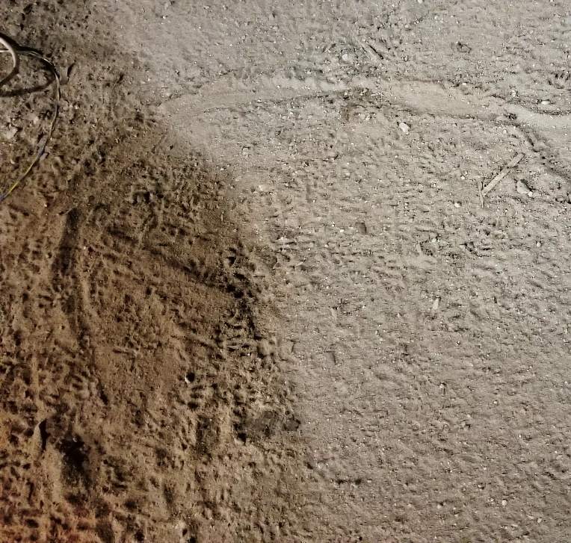
Tracks

Slide 40
What Can We Do?

Slide 41
Integrated pest management
Inspection—what’s the problem?
Identification—what’s the pest?
Sanitation—what is supporting the population?
Exclusion—how are they getting inside?
Treatment—how should we control them?
Exterior baiting program (organic options available)
Targeted treatments—burrow baiting
Interior inspection, monitoring, and trapping

Slide 42
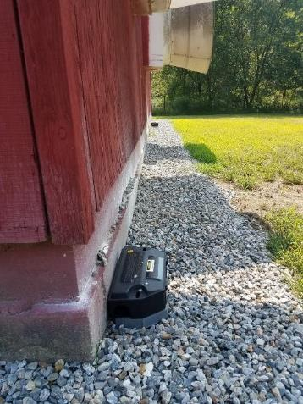
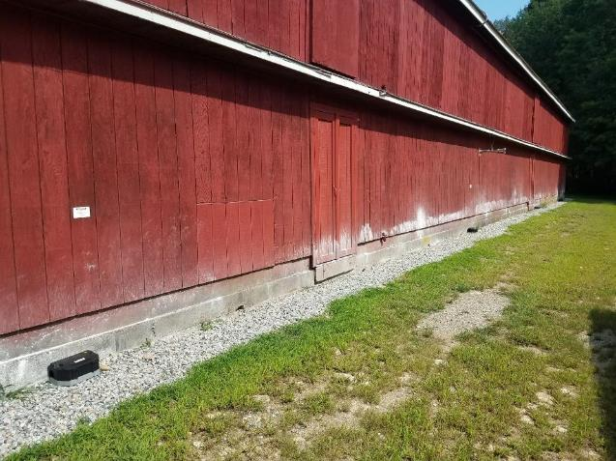
Protecting your perimeter

Slide 43
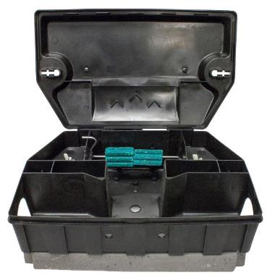
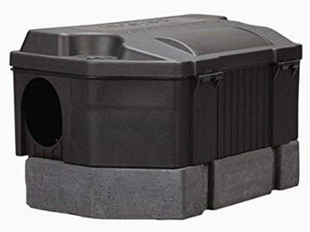
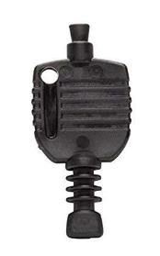
Safety features of exterior stations
Stone base acts as an anchor
Special key for tamper-resistance
Rods prevent bait from being shaken or pulled out

Slide 44
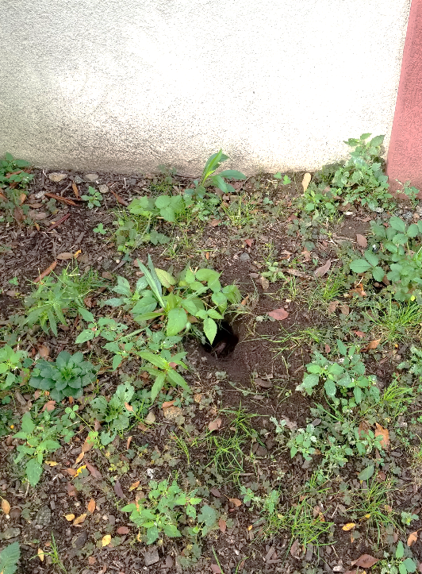
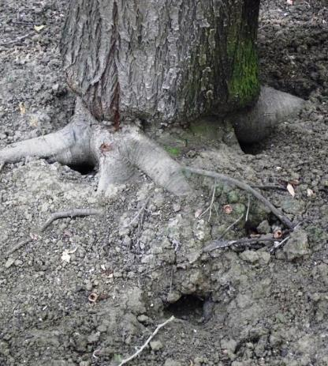
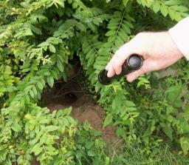
Finding and treating burrows

Slide 45
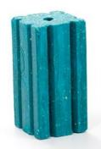
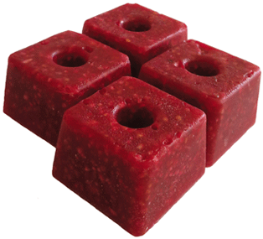
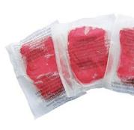
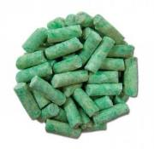
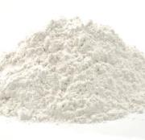
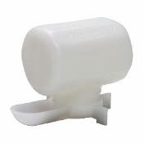
Pest management professionals
Choosing the right product or device for the situation
Choosing the right formulation of the product

Slide 46
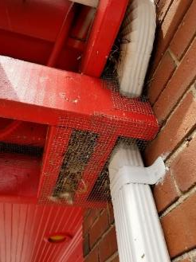
Pest management professionals
Applying that product or device properly
Where the pest will interact with it
According to label and law
With least risk to non-target animals
Routine monitoring
Education on mitigating pest pressure
Documentation of pest control services
Elimination or control of your pest problem

Slide 47
Natasha Wright, BCE
Board Certified Entomologist
Technical Director
nwright@bramanpest.com

