Slide 1
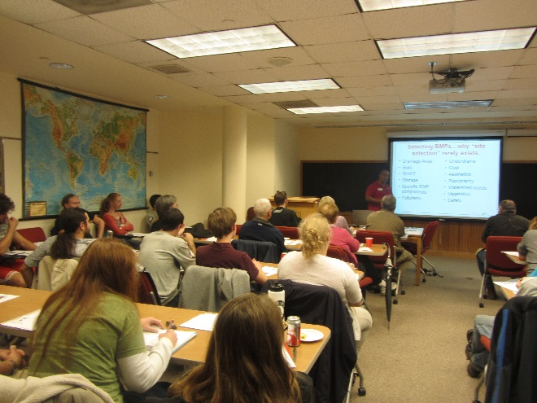
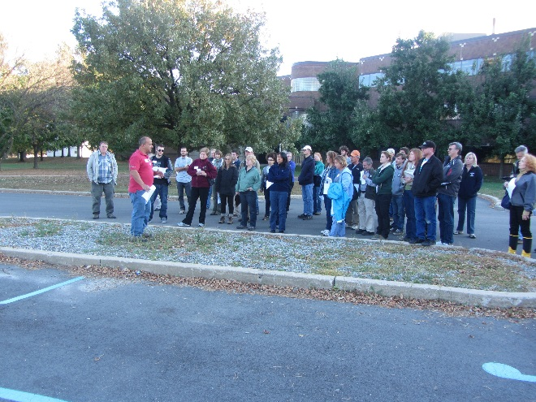
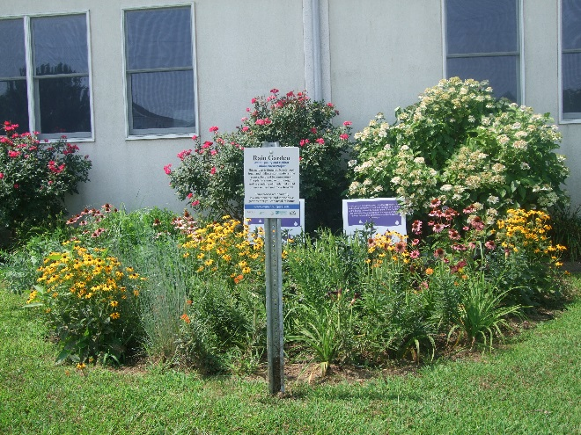
Building Robust Community Partnerships through the
Green Infrastructure Champions Program
Presented at the NE Urban Extension Conference in Springfield, MA
June 2023
Christopher C. Obropta, Ph.D., P.E.
Email: obropta@envsci.rutgers.edu
www.water.rutgers.edu

Slide 2
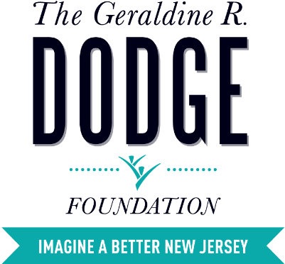
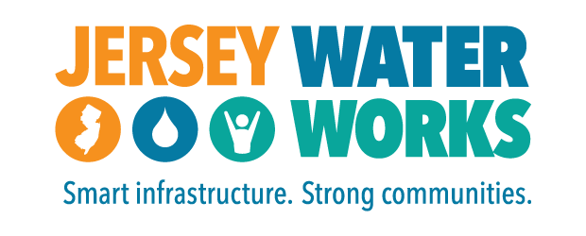

Slide 3
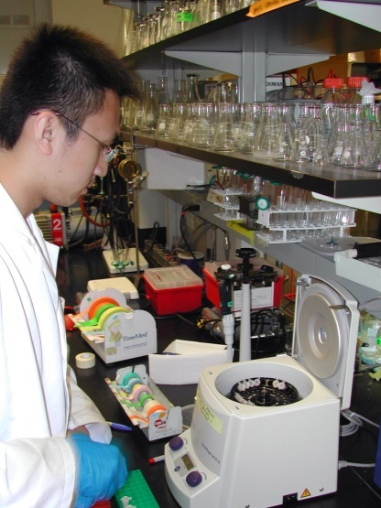
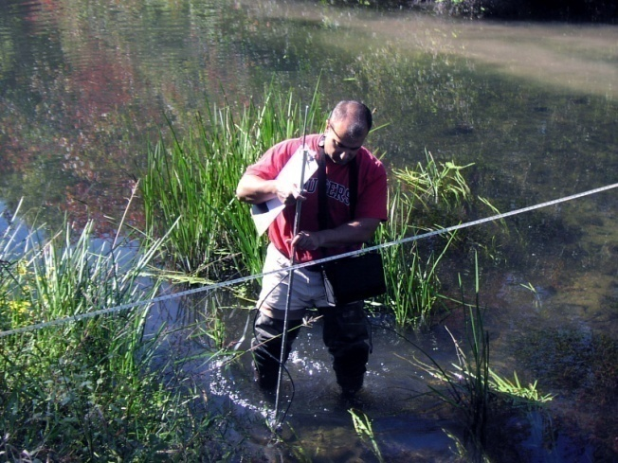
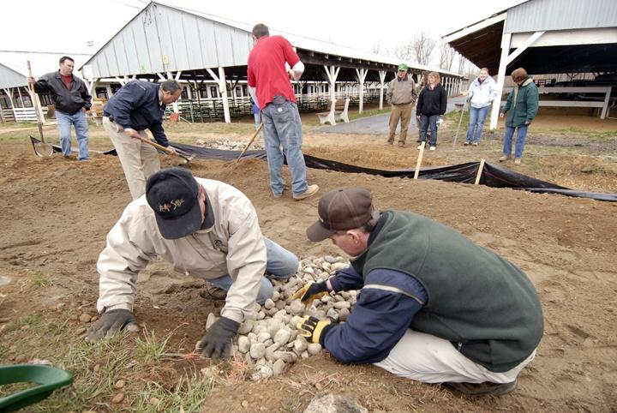
Rutgers Cooperative Extension
Rutgers Cooperative Extension (RCE) helps the diverse population of New Jersey adapt to a rapidly changing society and improves their lives through an educational process that uses science-based knowledge.

Slide 4
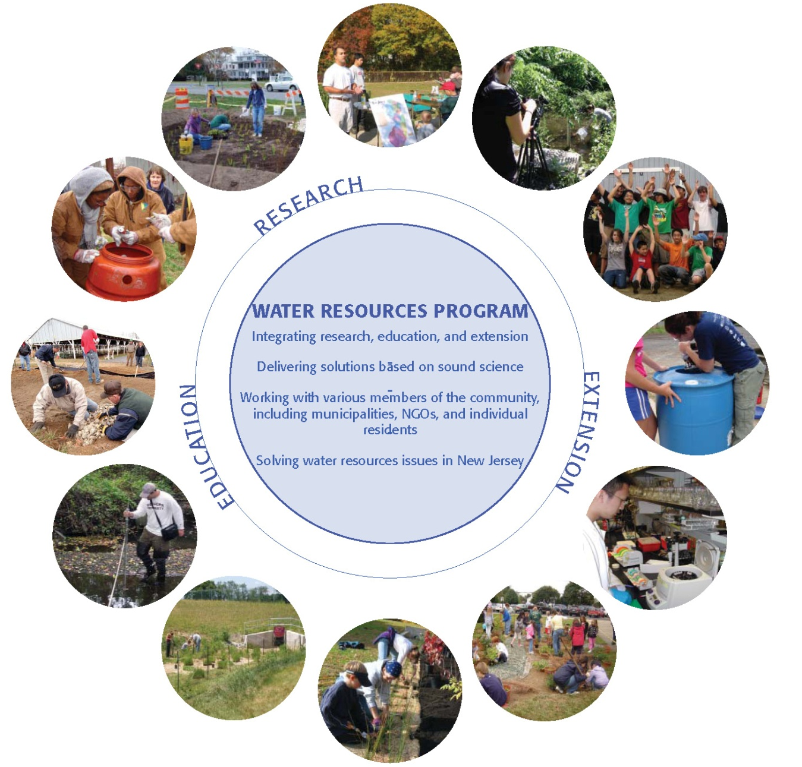
Water Resources Program
Our mission is to identify and address water resources issues by engaging and empowering communities to employ practical science-based solutions to help create a more equitable and sustainable New Jersey.

Slide 5
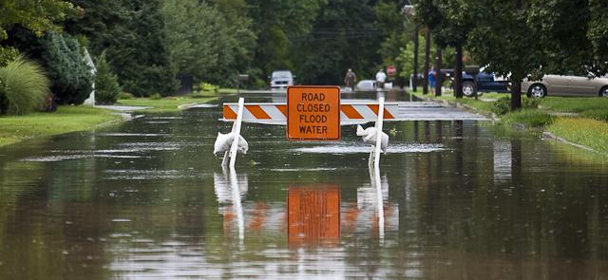
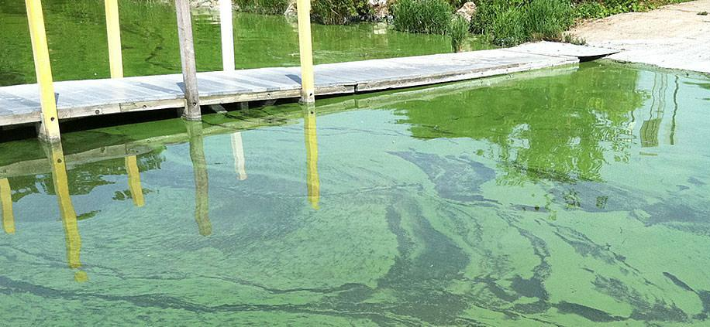
New Jersey
Most densely populated state
21 Counties, 565 municipalities
95% of our waterways are impaired
Harmful Algal Blooms (HABS) in many of our lakes
Hammered by Ida, Henri, Sandy, and a bunch of Nor’easters
Climate change is real – more severe storms and sea level rise

Slide 6
Water Quality Impairments in NJ
In 2002, 95% of NJ’s waterways were impaired
Lots of new laws were passed:
2004 New Stormwater Management Regulations
2004 Municipal Separate Storm Sewer System (MS4) Permits issued
2011 New Jersey Fertilizer Law
2021 Updated Stormwater Management Regulations
In 2022, 95% of NJ’s waterways are impaired
Population increased by 724,000
Urban Land Uses increased by 57,203 acres

Slide 7
Insight to current problem
Stringent stormwater regulations on new development has not improved water quality
We must retrofit existing older development with stormwater management to reduce impairments to our waterways
Green infrastructure is a great tool to retrofit existing older development
Local champions are needed to advocate for green infrastructure retrofits
We need to create these champions where they don’t already exist

Slide 8
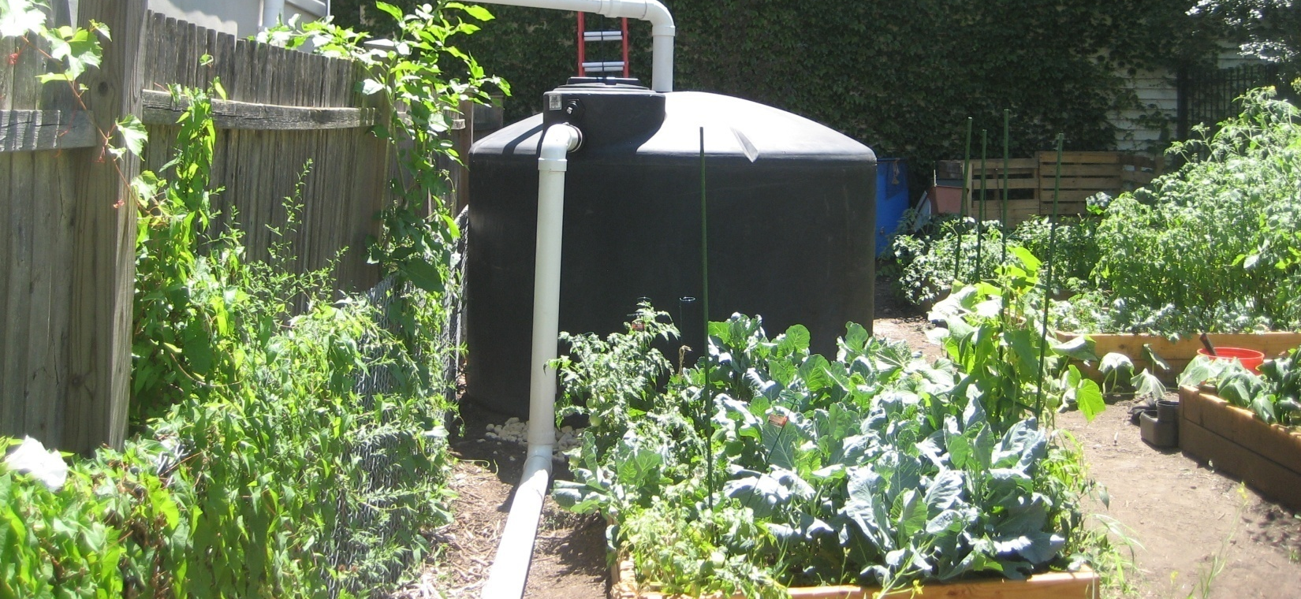
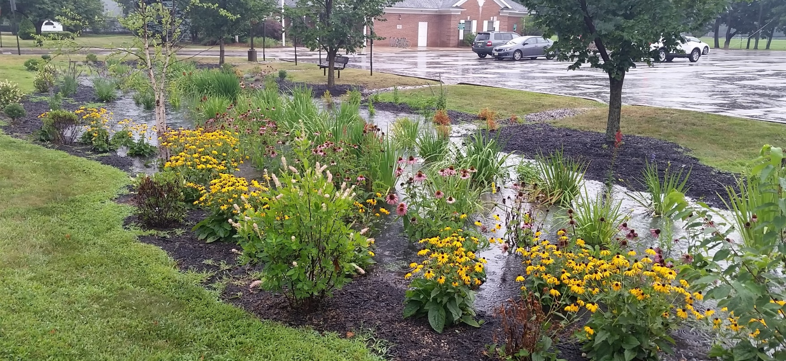
Green infrastructure in New Jersey

Slide 9
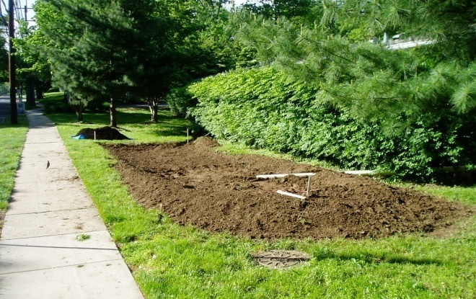
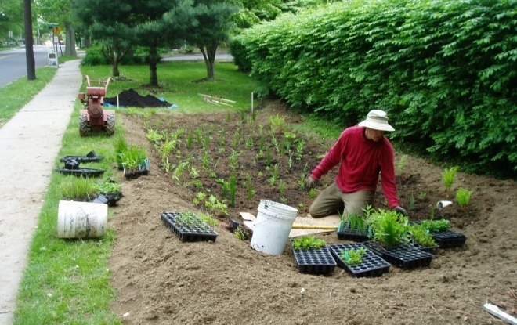
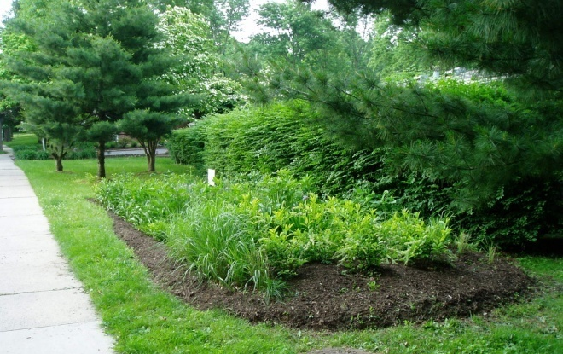
Green Infrastructure is ...
…an approach to stormwater management that is cost-effective, sustainable, and environmentally friendly.
Green Infrastructure projects:
capture,
filter,
absorb, and
reuse
stormwater to restore the natural water cycle.

Slide 10
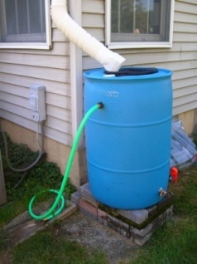
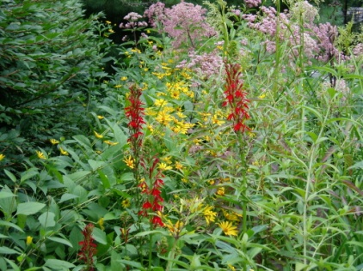
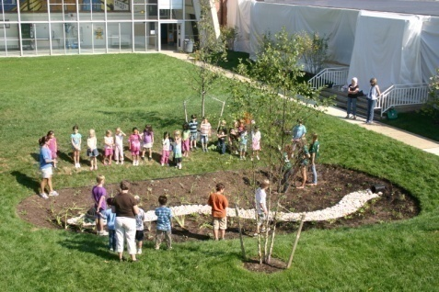
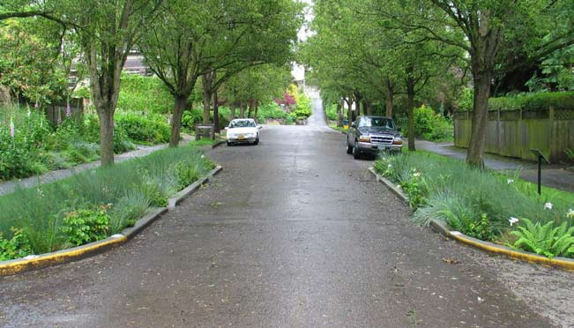
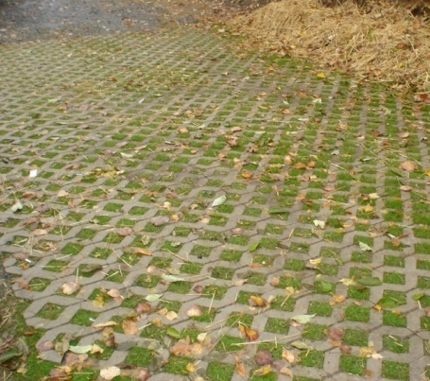
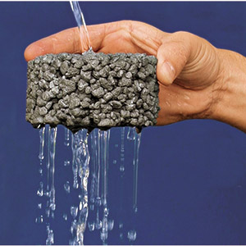
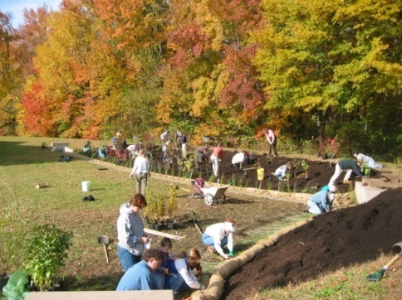
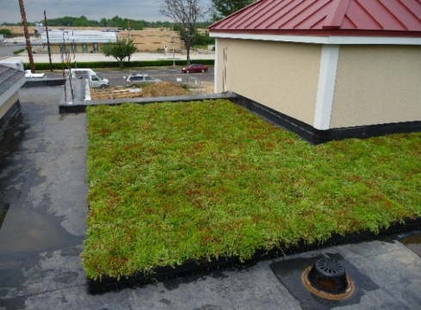
Green Infrastructure Practices
Bioretention Systems
Rain Gardens
Bioswales
Stormwater Planters
Curb Extensions
Tree Filter Boxes
Permeable Pavements
Rainwater Harvesting
Rain barrels
Cisterns
Dry Wells
Rooftop Systems
Green Roofs
Blue Roofs
Parker Urban Greenscapes. 2009.
Notes:
Most green infrastructure practices are designed to improve water quality, namely, to capture the first 1” of stormwater runoff, known as the first flush. During a storm event, a majority of the pollution washes off the land in the first 20 minutes. So, if you can capture and treat this first flush, we can go a long way to improving water quality and maybe eliminate some localize flooding from smaller storms but what about the infamous 100-Year storm?

Slide 11
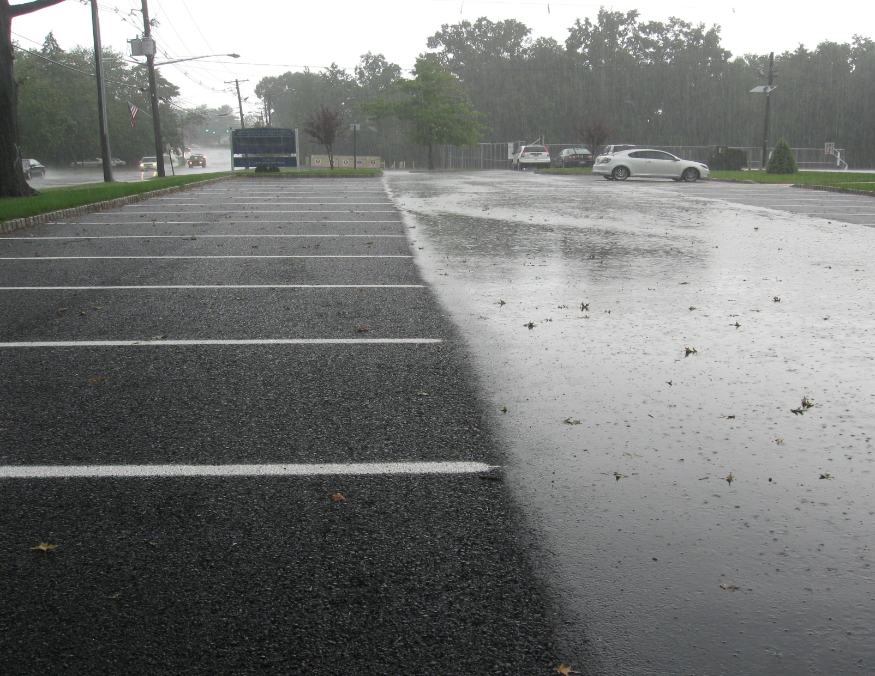
Role of Green Infrastructure (GI) in NJ
New “Major” Development is required to use GI to maintain groundwater recharge and reduce Total Suspended Solids (TSS) from runoff
Communities with combined sewers are using GI to reduce stormwater into system to prevent overflows (GI partially required)
On a voluntary basis, existing development, is being retrofitted with GI to help improve water quality and reduce flooding

Slide 12
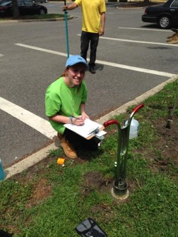
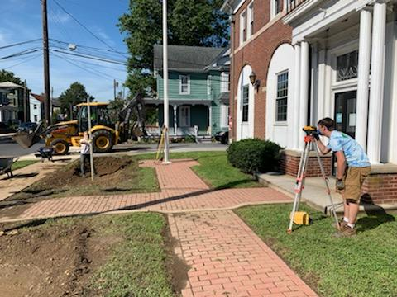
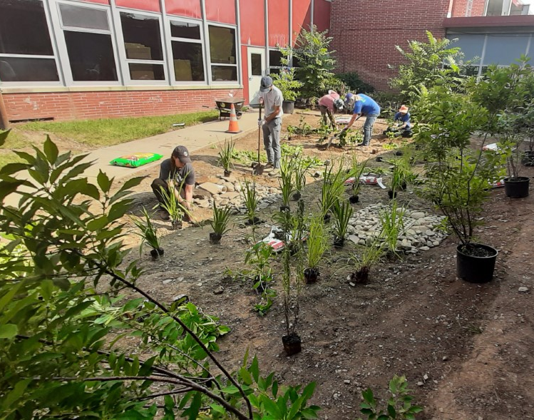
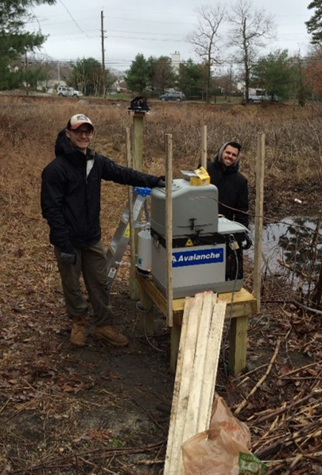
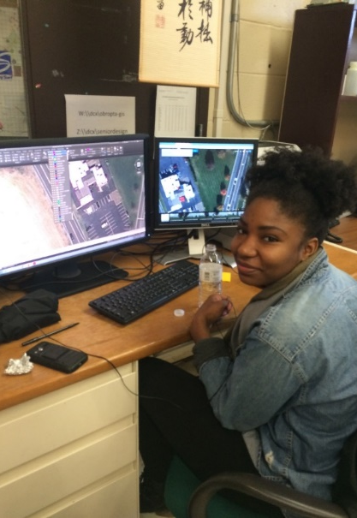
Role of Rutgers
Educate community leaders, municipal officials, environmental commissioners, engineers, landscape architects, and planners on new regulations and green infrastructure
Help CSO communities advocate for GI and identify appropriate locations
Create local champions to promote GI for retrofitting existing development
Help communities develop green infrastructure action plans, design demonstration projects, and install projects

Slide 13
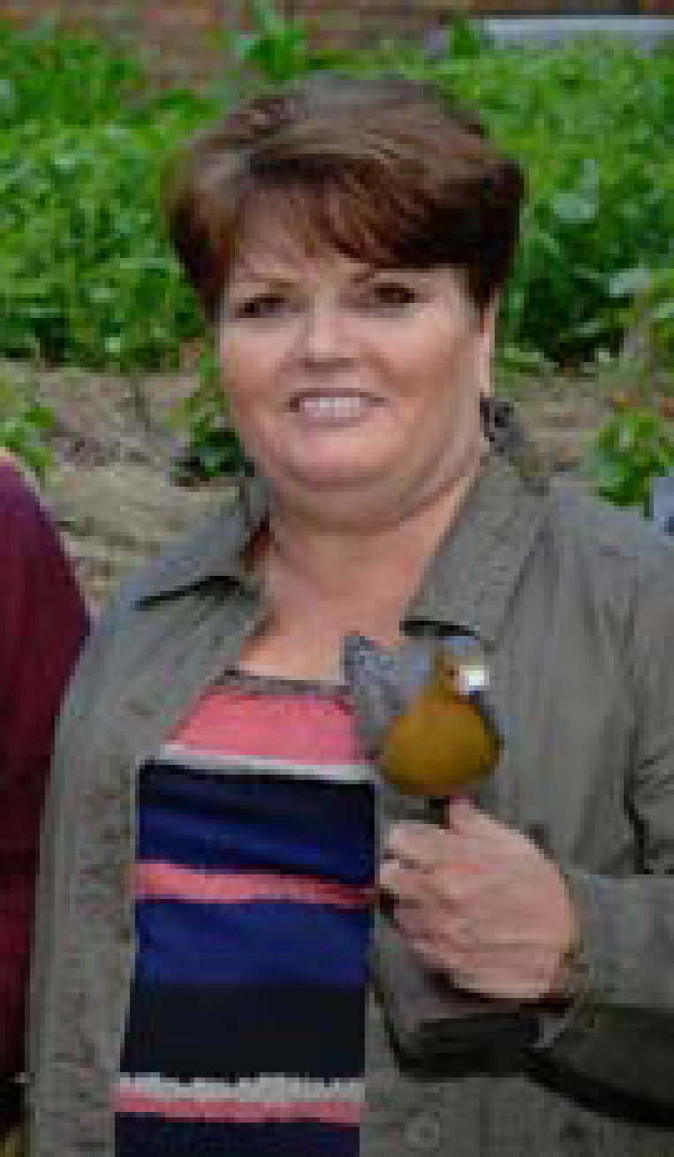
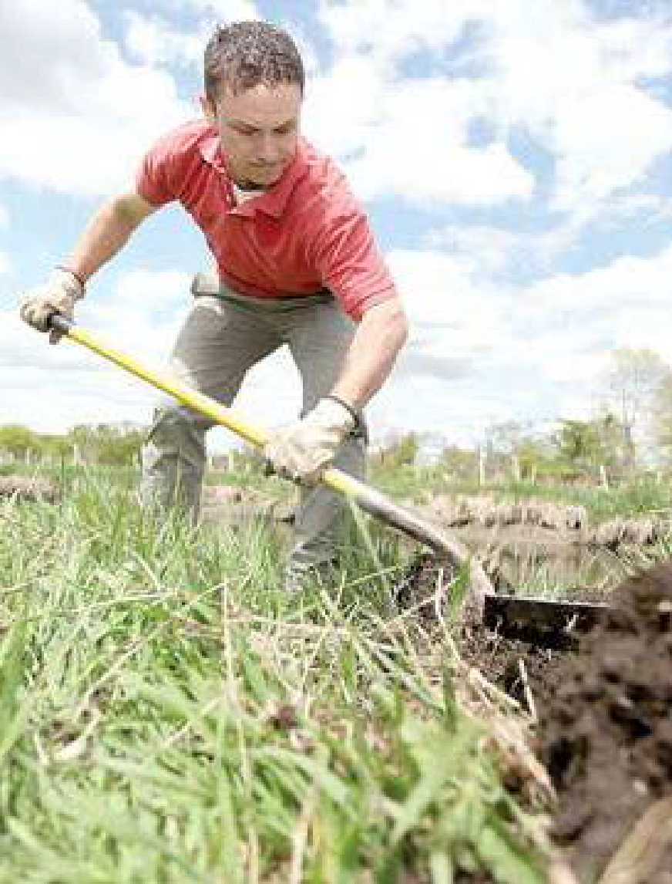
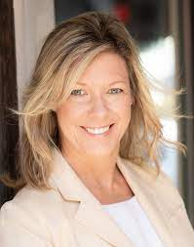
Green Infrastructure Champions
Green Infrastructure Champions are key players in implementing green infrastructure as a stormwater management approach in their community.
Cheryl Reardon works for the Association of New Jersey Environmental Commissions
Nathaniel Sajdak works for the Wallkill River Watershed Management Group
Laura McBride created the Deal Lake Watershed Alliance

Slide 14
Rutgers inputs to the Green Infrastructure Champion Program
10 training classes on various aspects of green infrastructure planning and implementation
Professional staff to provide technical support to develop a design for a green infrastructure demonstration project
Networking opportunities with other Green Infrastructure Champions for mutual support
Assistance with grant writing and submission

Slide 15
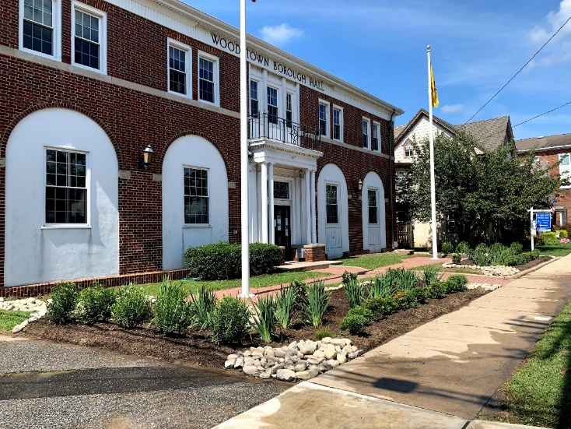
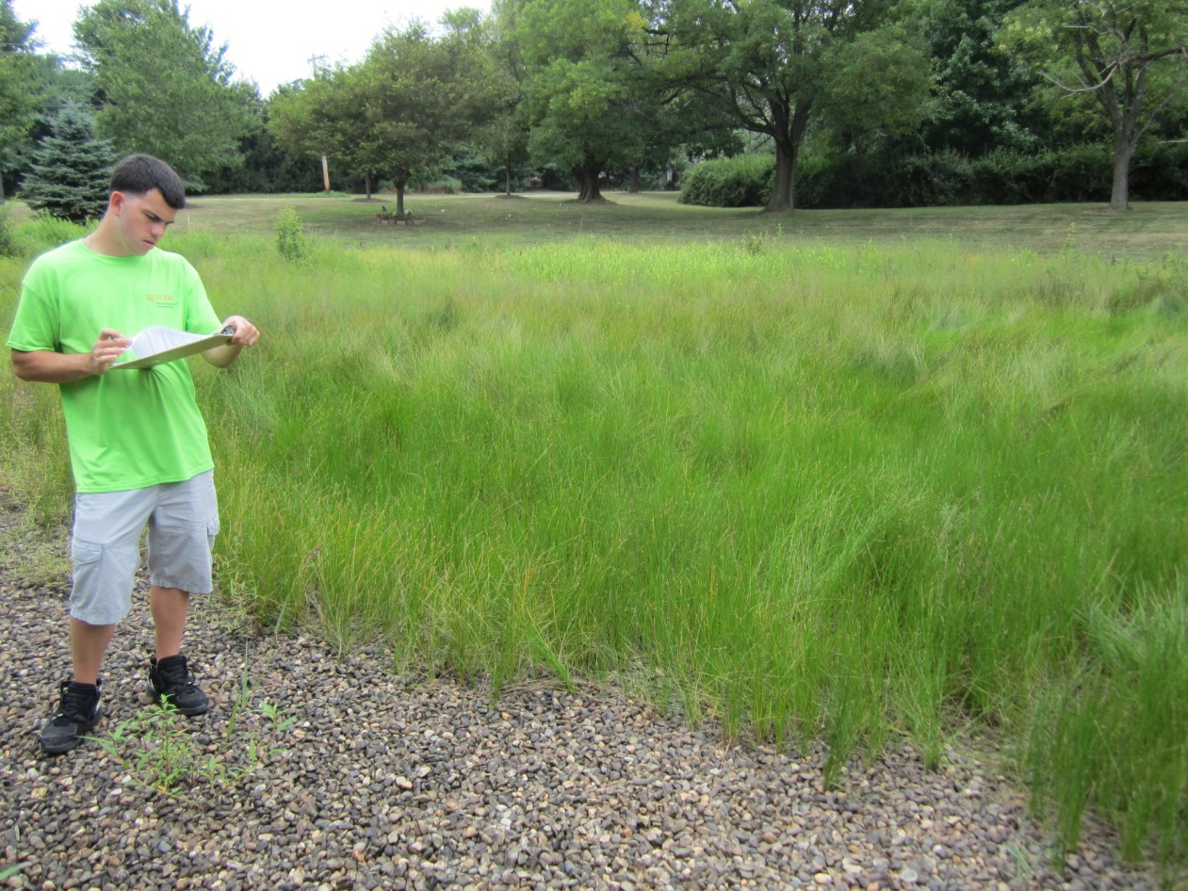
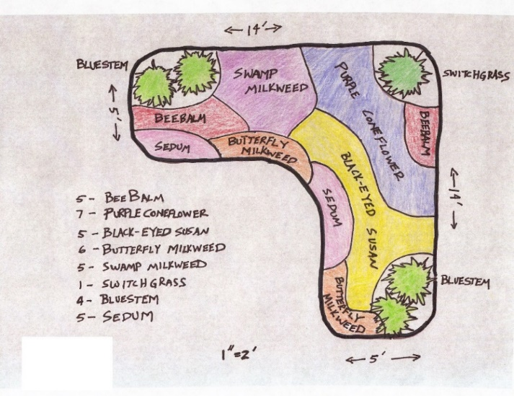
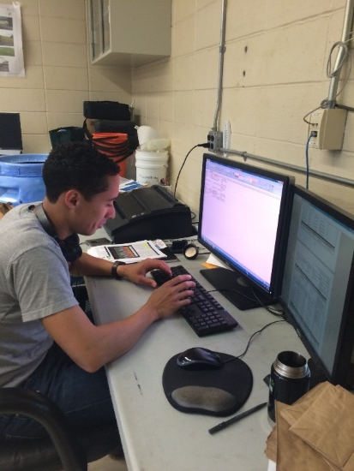
GI Champions Classes
1. “How to identify green infrastructure projects in your town”
This workshop will provide an overview of green infrastructure practices and how to identify sites that can be retrofitted with green infrastructure. The variables that should be considered in selecting the most appropriate green infrastructure practice will be discussed. A green infrastructure site assessment checklist will be provided to all attendees.
2. “Moving from planning to implementation of green infrastructure”
The various components of green infrastructure planning will be discussed including tools that can be used to help prepare these plans. The implementation of green infrastructure projects that have been identified through the planning process will be the main focus of this workshop. Leveraging existing projects, building partnerships, writing grants and project costs will be discussed. Lessons learned during implementation will also be covered.

Slide 16
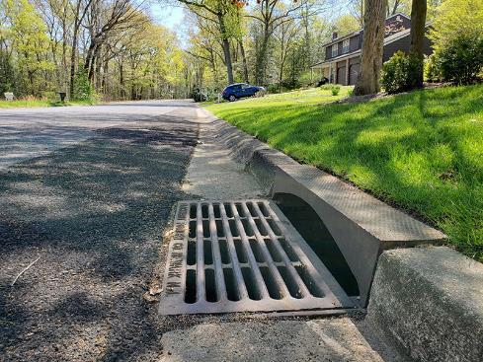
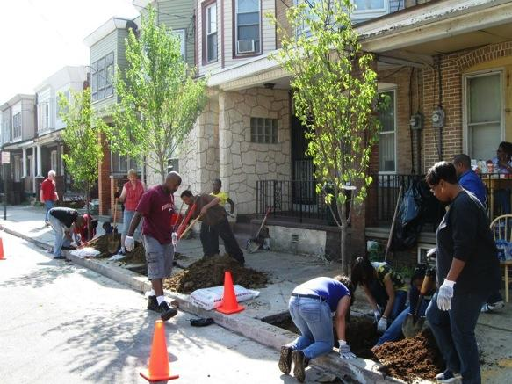
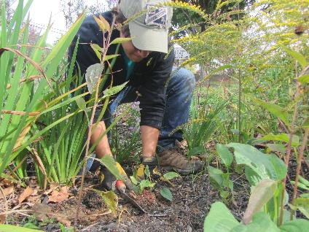
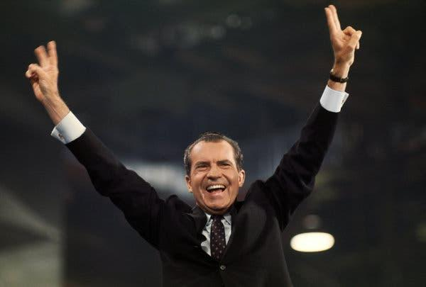
GI Champions Classes
3. “Maintaining green infrastructure practices/projects”
The key to long-term success of green infrastructure is maintenance. This workshop will discuss the maintenance requirements for each green infrastructure practice. Model maintenance agreements will be shared and discussed. Cost of maintenance will be covered in the workshop as well.
4. "Stormwater management regulations, policies, and ordinances"
Many people look to state and local policies, regulations, and ordinances to actuate a long-term change in how communities address stormwater issues. This workshop will discuss the current regulations and offer examples of policies and ordinances that can help communities reduce flooding and improve the health of their waterbodies.

Slide 17
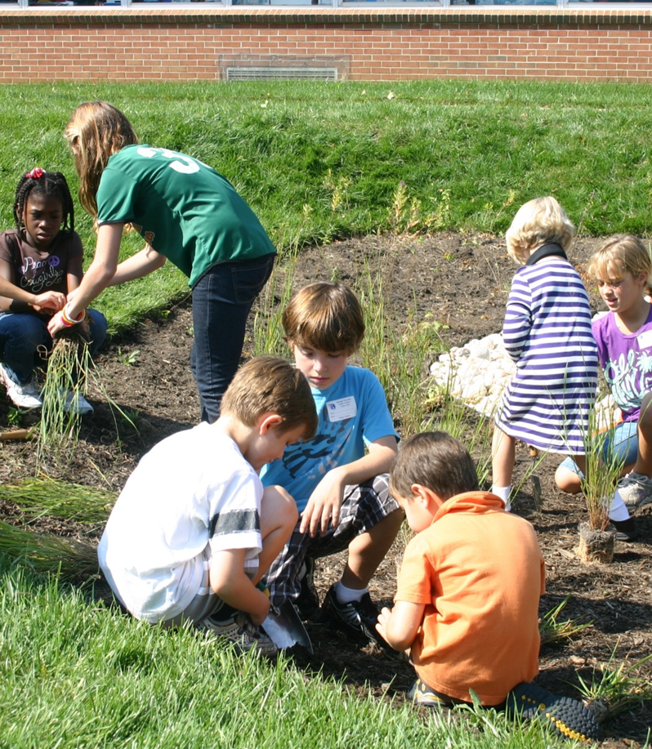
GI Champions Classes
5. "Green infrastructure planning and implementation for Sustainable Jersey points"
Green infrastructure planning and implementation activities can be used to earn points through the Sustainable Jersey Program. This workshop discusses planning as well as implementation activities that can be completed to obtain Sustainable Jersey points.
6. "Green infrastructure projects for schools“
Public, private, and charter schools all tend to provide opportunities for green infrastructure. This workshop will discuss green infrastructure projects for schools and educational programs that can accompany these projects to engage school children, their parents, and teachers.

Slide 18
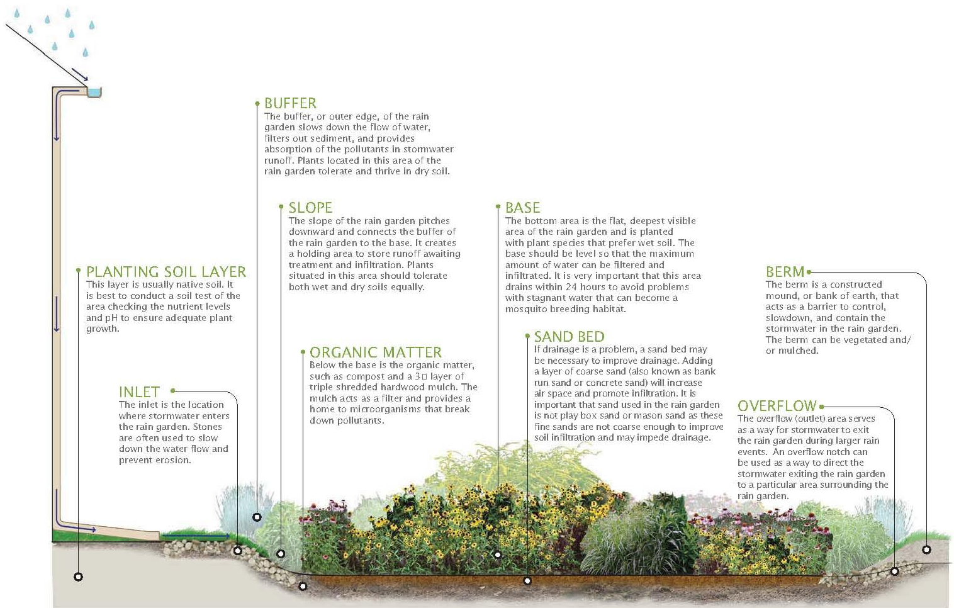
GI Champions Classes
7. "How to design and build a rain garden"
One of the easiest green infrastructure practices to design and build is the rain garden. In this workshop, attendees will learn how to design and build a rain garden. The workshop will include useful tools for design including the New Jersey Rain Garden Manual and the Rain Garden App. The workshop will not only teach attendees how to properly size a rain garden but also how to select plants.
8. "Retrofitting traditional detention basins with green infrastructure“
Detention basins have been used throughout New Jersey since the early 1980s. While these basins do reduce stormwater runoff peak flows from developed areas, they do very little to reduce stormwater runoff volumes or pollutant loads. This workshop will discuss retrofitting detention basins to improve their infiltration capacity and enhance their ability to reduce pollutant loads. The retrofitting of basins will also reduce maintenance, mainly the need to mow..

Slide 19
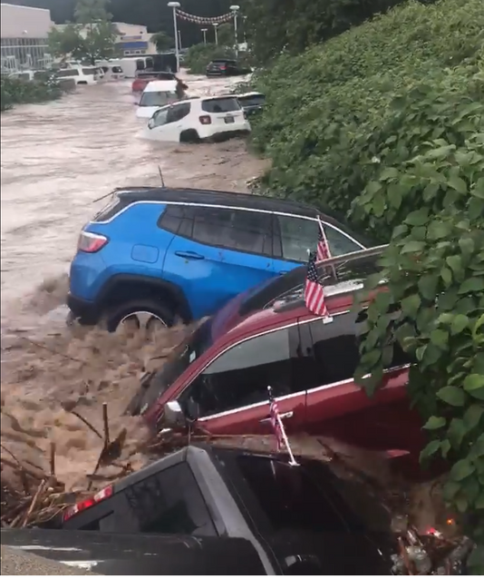
GI Champions Classes
9. "Developing green infrastructure master plans for an entire site or neighborhood"
Many communities have installed a green infrastructure demonstration project. This workshop helps attendees build upon that individual project to create master plans for an entire site, municipal complex, school ground, corporate complex, or a neighborhood. The master plan goes beyond managing stormwater with green infrastructure and incorporates a wide range of amenities.
10. "Using green infrastructure to promote climate resiliency"
Climate changes, including rising sea level, more intense storms, and longer periods of drought between storms, can increase stormwater runoff. Green infrastructure practices can be used to minimize these impacts and promote climate resiliency. This workshop will discuss opportunities for green infrastructure to mitigate the effects of climate change as well as the design considerations that must be made to combat changing rainfall patterns and sea level rise.

Slide 20
Short-term results/impacts Green Infrastructure Champions will:
Increase their knowledge and awareness about green infrastructure practices, planning, and implementation
Gain a skill set to allow them to engage community leaders, schools, and non-governmental organizations (NGOs) and advocate for green infrastructure as a stormwater management solution
Identify funding opportunities and secure funding for green infrastructure

Slide 21
Long-term results/impacts
Green infrastructure practices are installed throughout the community
Green infrastructure becomes a standard in the community for addressing stormwater problems
Localized flooding is reduced
Water quality improves
Community become more resilient to extreme weather events

Slide 22
402 Certified Champions

Slide 23
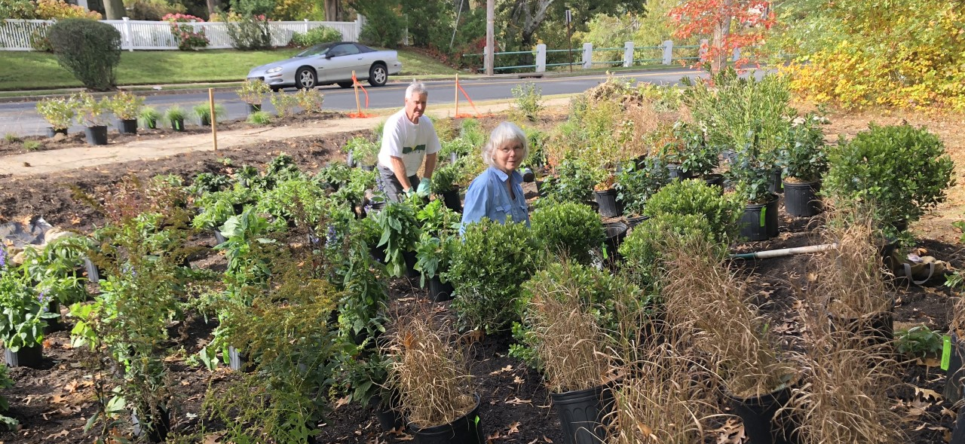
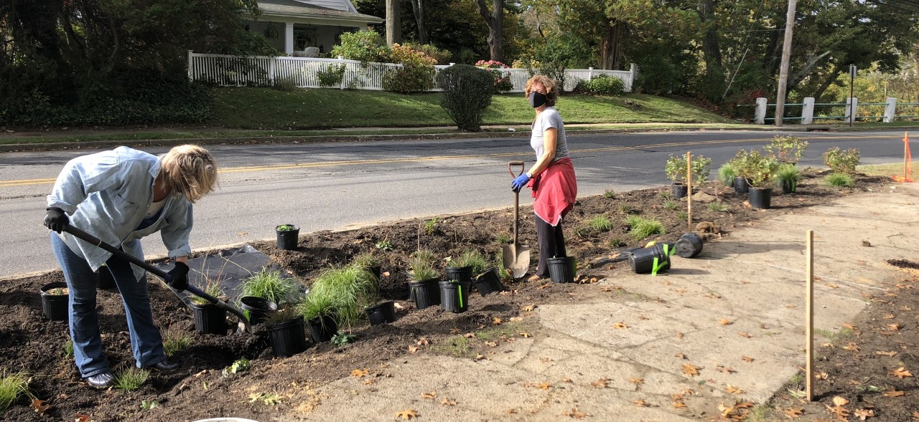
Examples:
Council members in Caldwell, NJ applied for a grant and received a grant to complete green infrastructure plans for the municipality and to build two rain gardens.
Laura McBride created the Deal Lake Alliance and developed a Green Infrastructure Study for Deal Lake Watershed. Also, she installed green infrastructure to protect Deal Lake.
Members of Save the Barnegat Bay are using our presentation we provided them to give rain garden talks to local groups and municipalities about how rain gardens are beneficial.

Slide 24
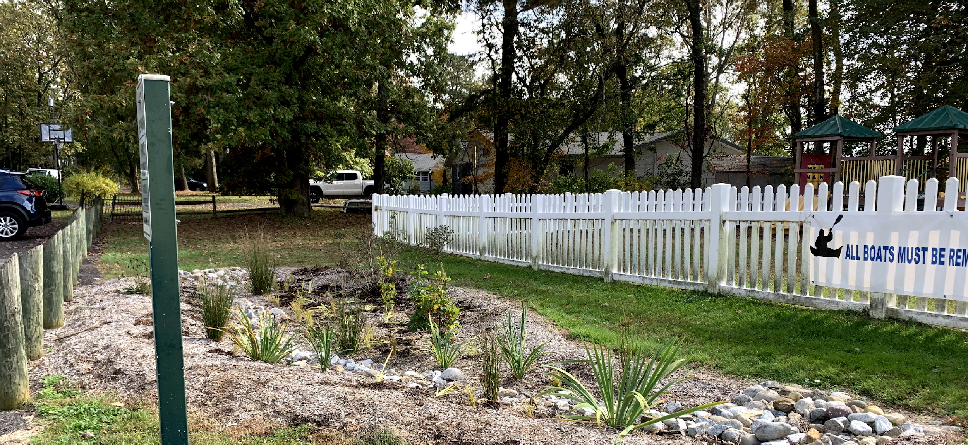
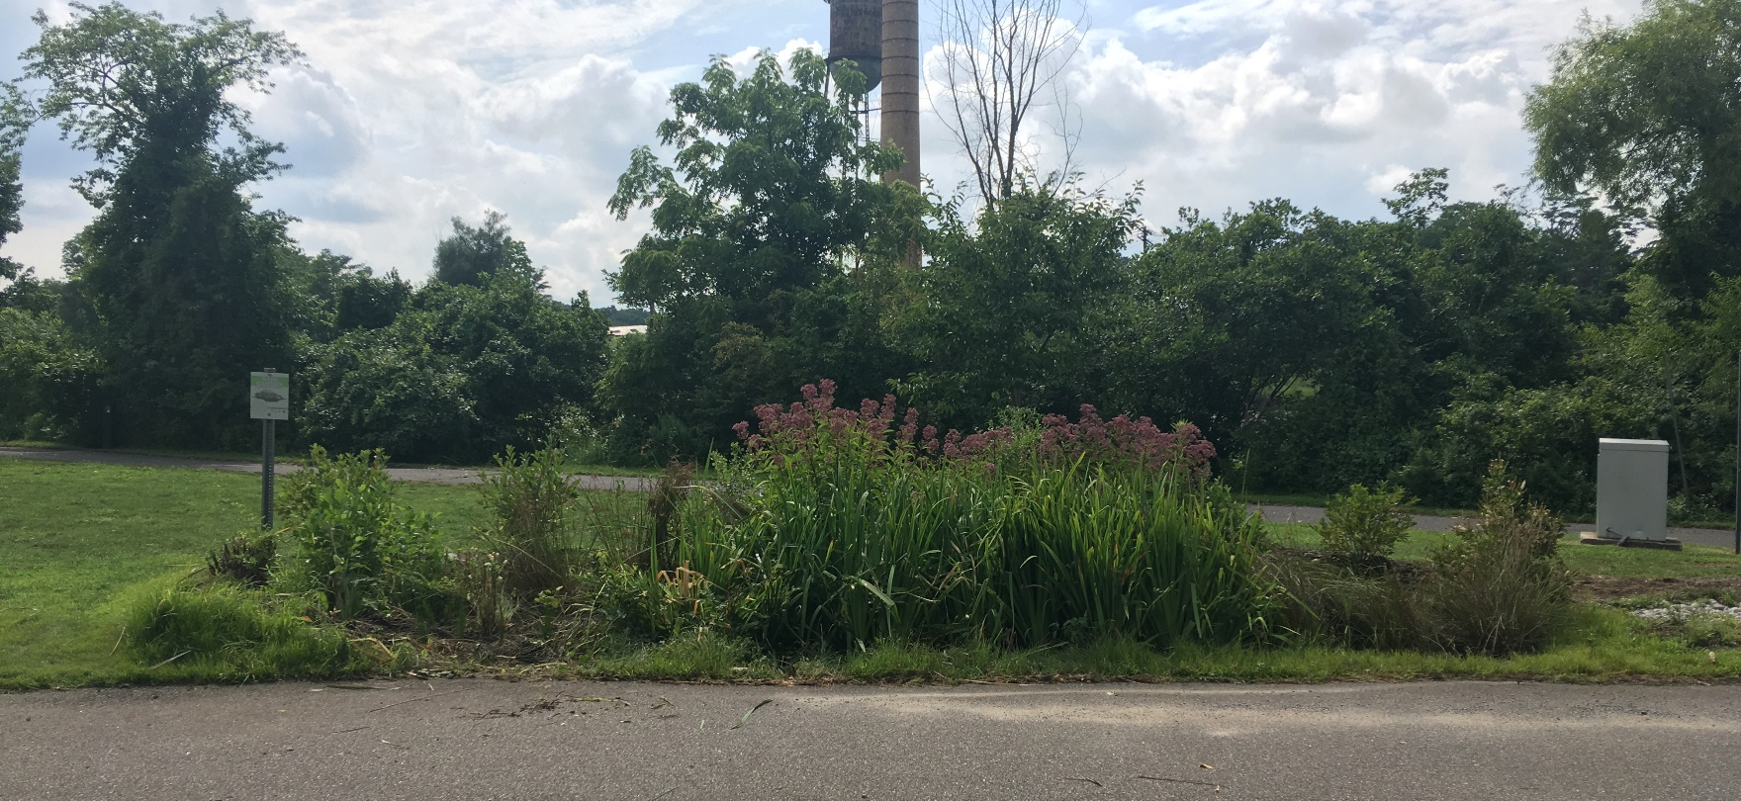
Examples:
Doriann Kerber of Milltown is supporting10 green infrastructure projects (½ in her town and ½ in other surrounding towns). She recently accepted the position of the State Environmental Chair of the Lions Club Int’l where she will dramatically broaden her influence.
Ila Vassallo, Chair of the Evesham Environmental Commission lead the installation of GI projects in her community and help pass stormwater ordinances to protect local waterways. She also has engaged many township departments, community groups, and the utilities authority in her green infrastructure projects.

Slide 25
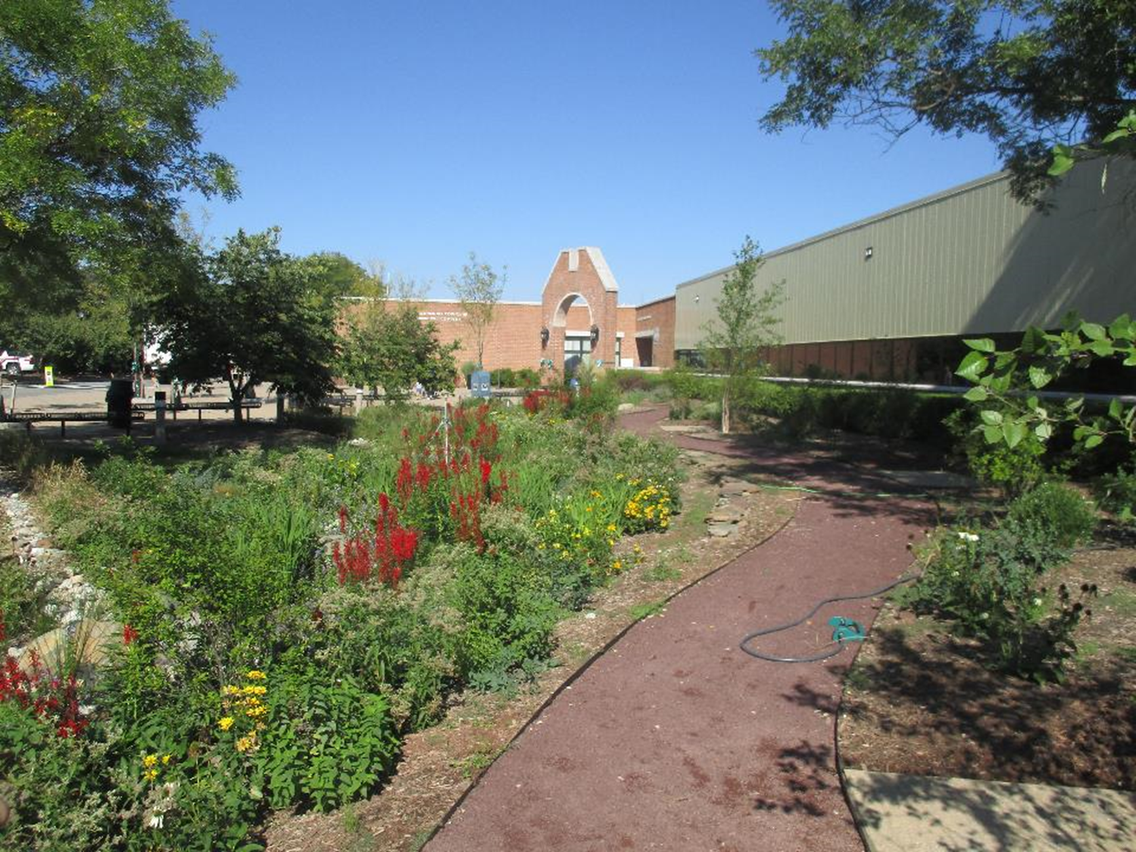
Examples:
David Kois is a Township Planner and Zoning Official. He helped develop a green infrastructure master plan for the Hillsborough Municipal Complex. He led the effort to install five rain gardens and naturalize on detention basin. He has secured over $100k for green infrastructure projects in his town. David has changed the culture of the municipal government employees to embrace green infrastructure. He created the first rain garden maintenance easement template and requires homeowners to install green infrastructure to offset increases in impervious cover.

Slide 26
Next Steps
Expending the GI Champions Program throughout the Northeast
Advance classes
Integrating gray with green to manage large storms
Living shorelines, floodplain restoration, and stormwater wetlands
Advocacy Strategies for Green Infrastructure
Green Infrastructure Program for Youth
Dedicated demonstration project funding for champions
Create online learning tools
Hands-on workshops

Slide 27
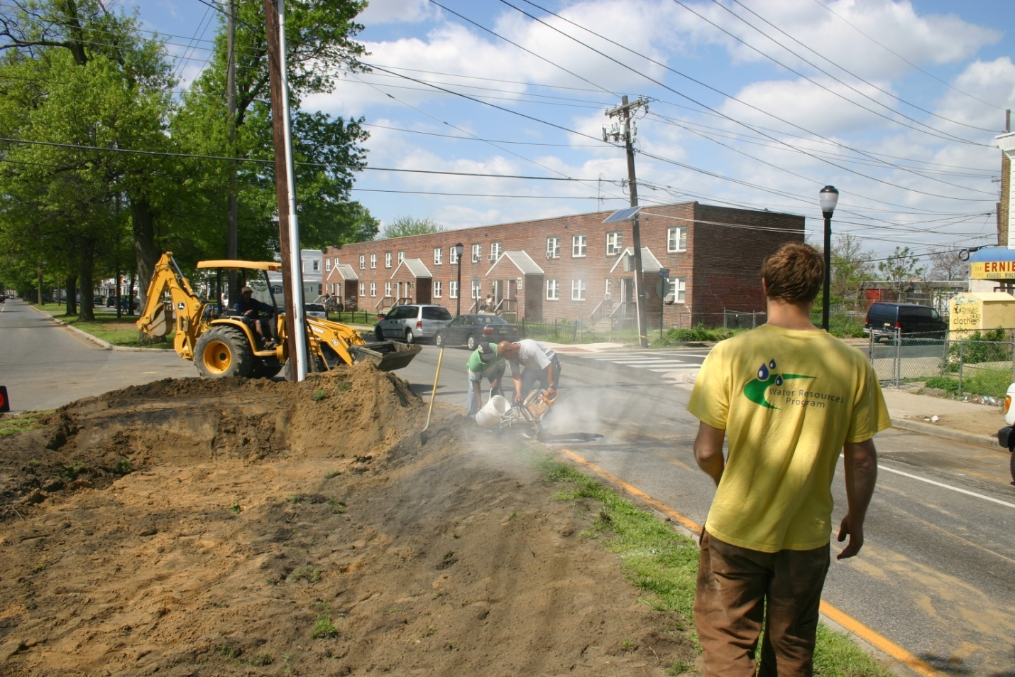
Rutgers Cooperative Extension Water Resources Program
Christopher C. Obropta, Ph.D., P.E.
Phone: 848-932-5711
Email: obropta@envsci.rutgers.edu

